Slide 1
University of Diyala
College of Engineering
Department of Communications Engineering
م. خالد حسين خضير

Slide 2
Lecture # 10

Slide 3
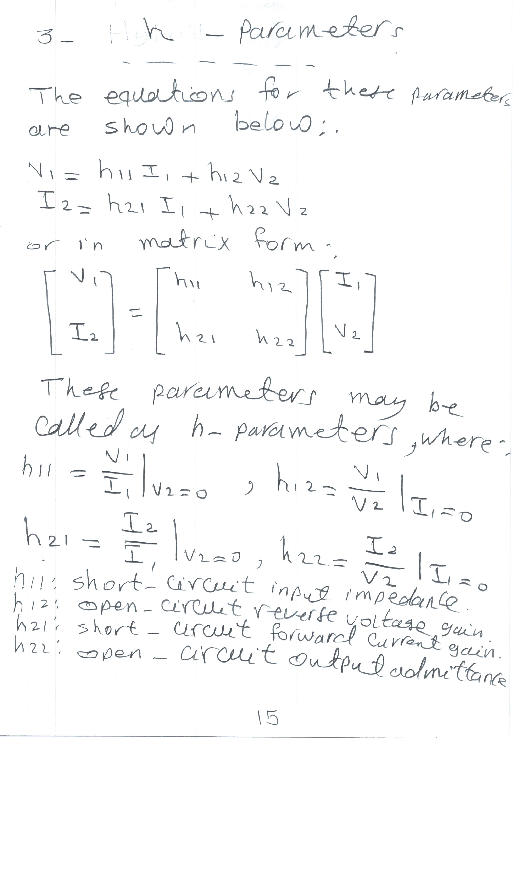

Slide 4
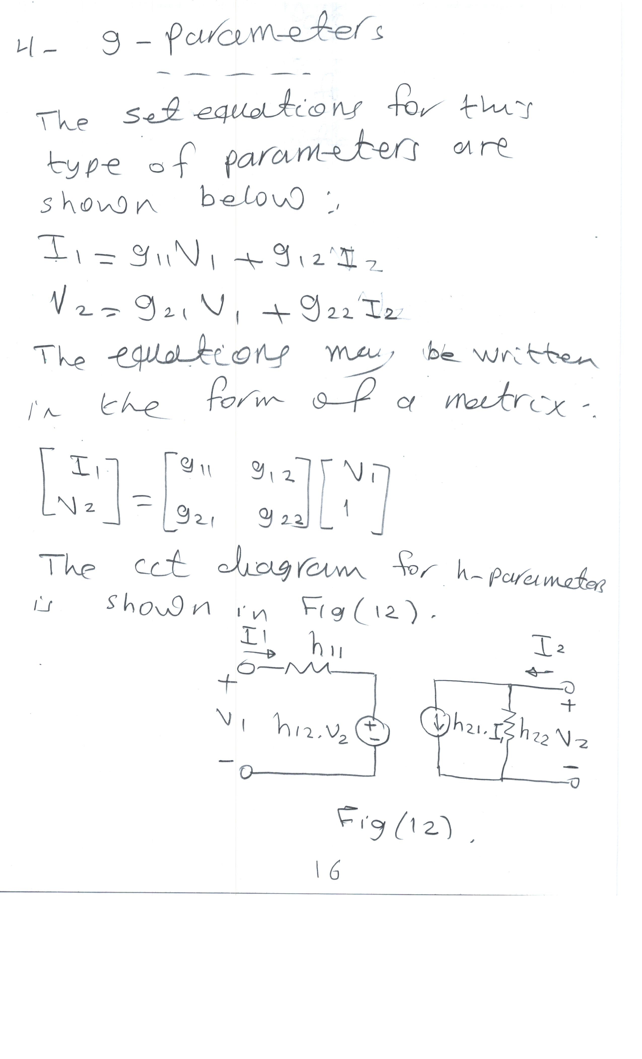

Slide 5
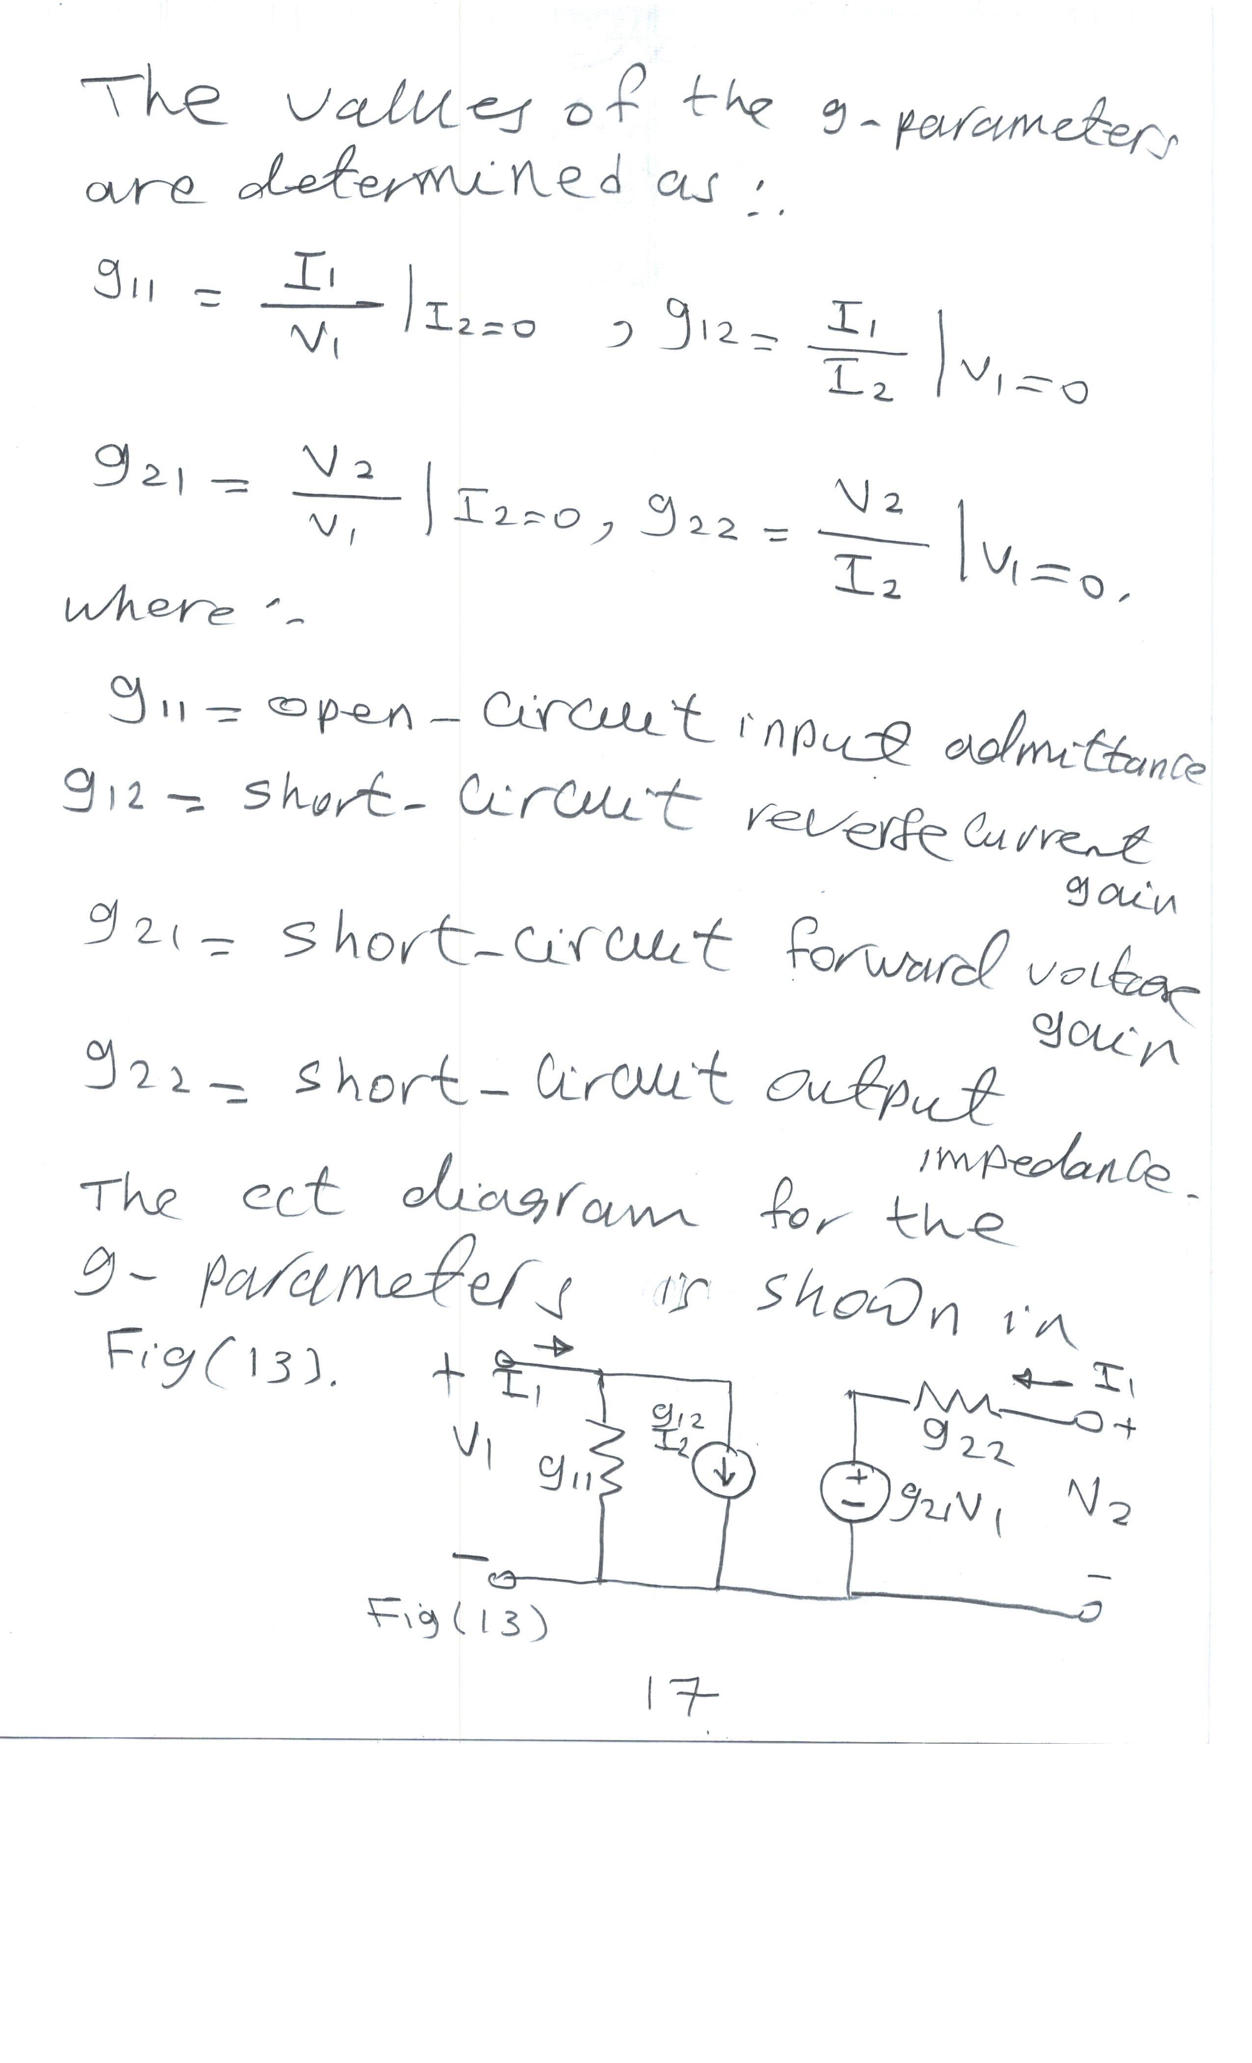

Slide 6
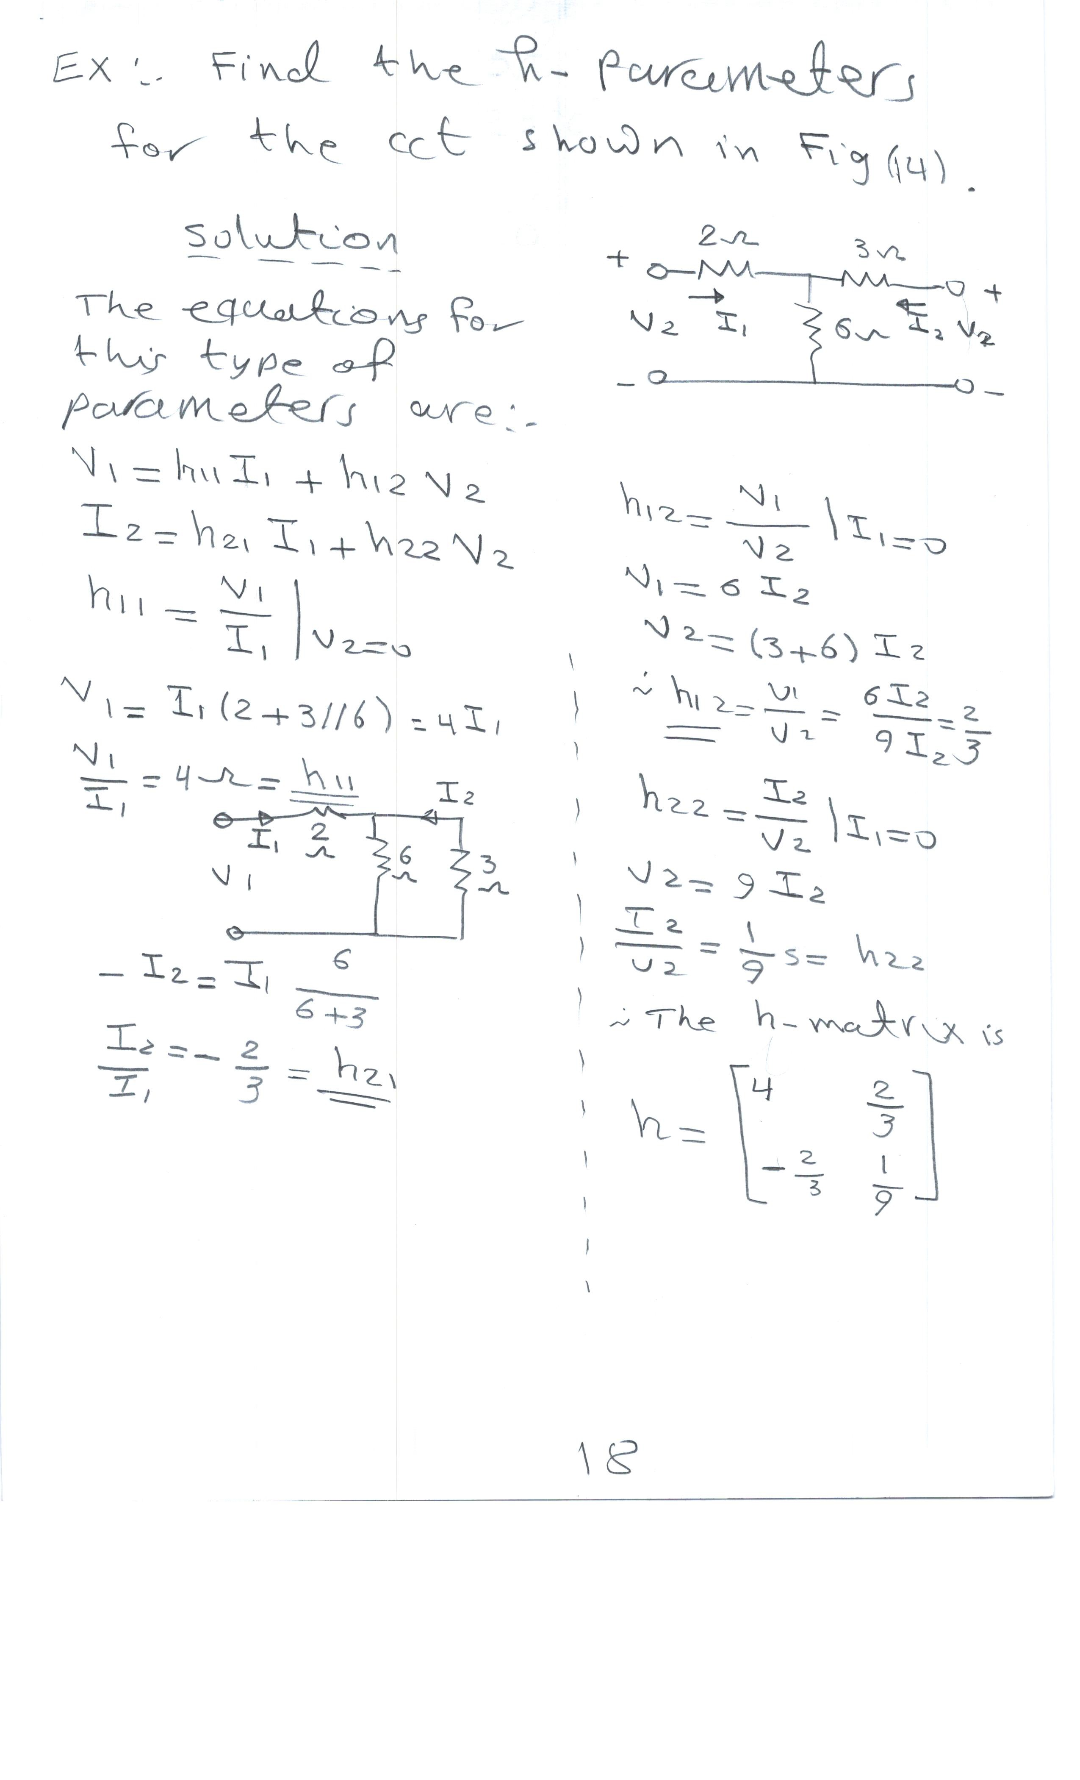

Slide 7
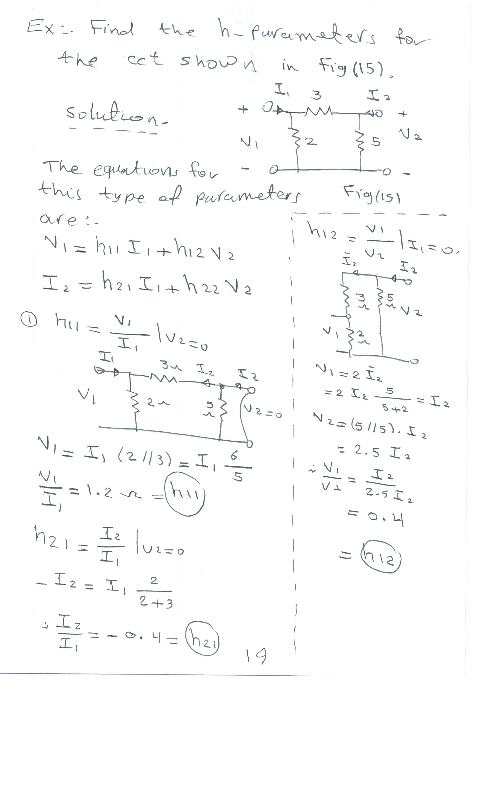

Slide 8
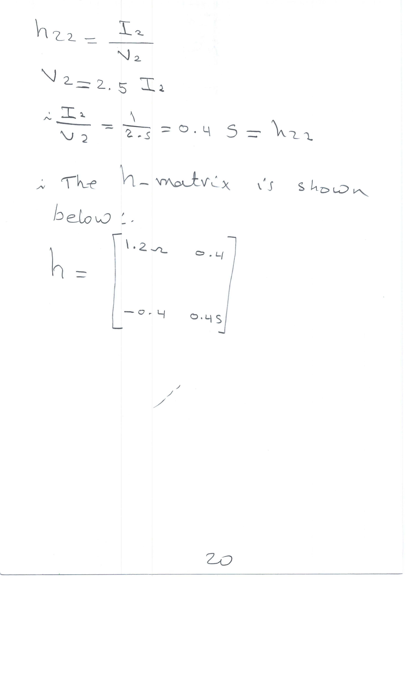

Slide 9
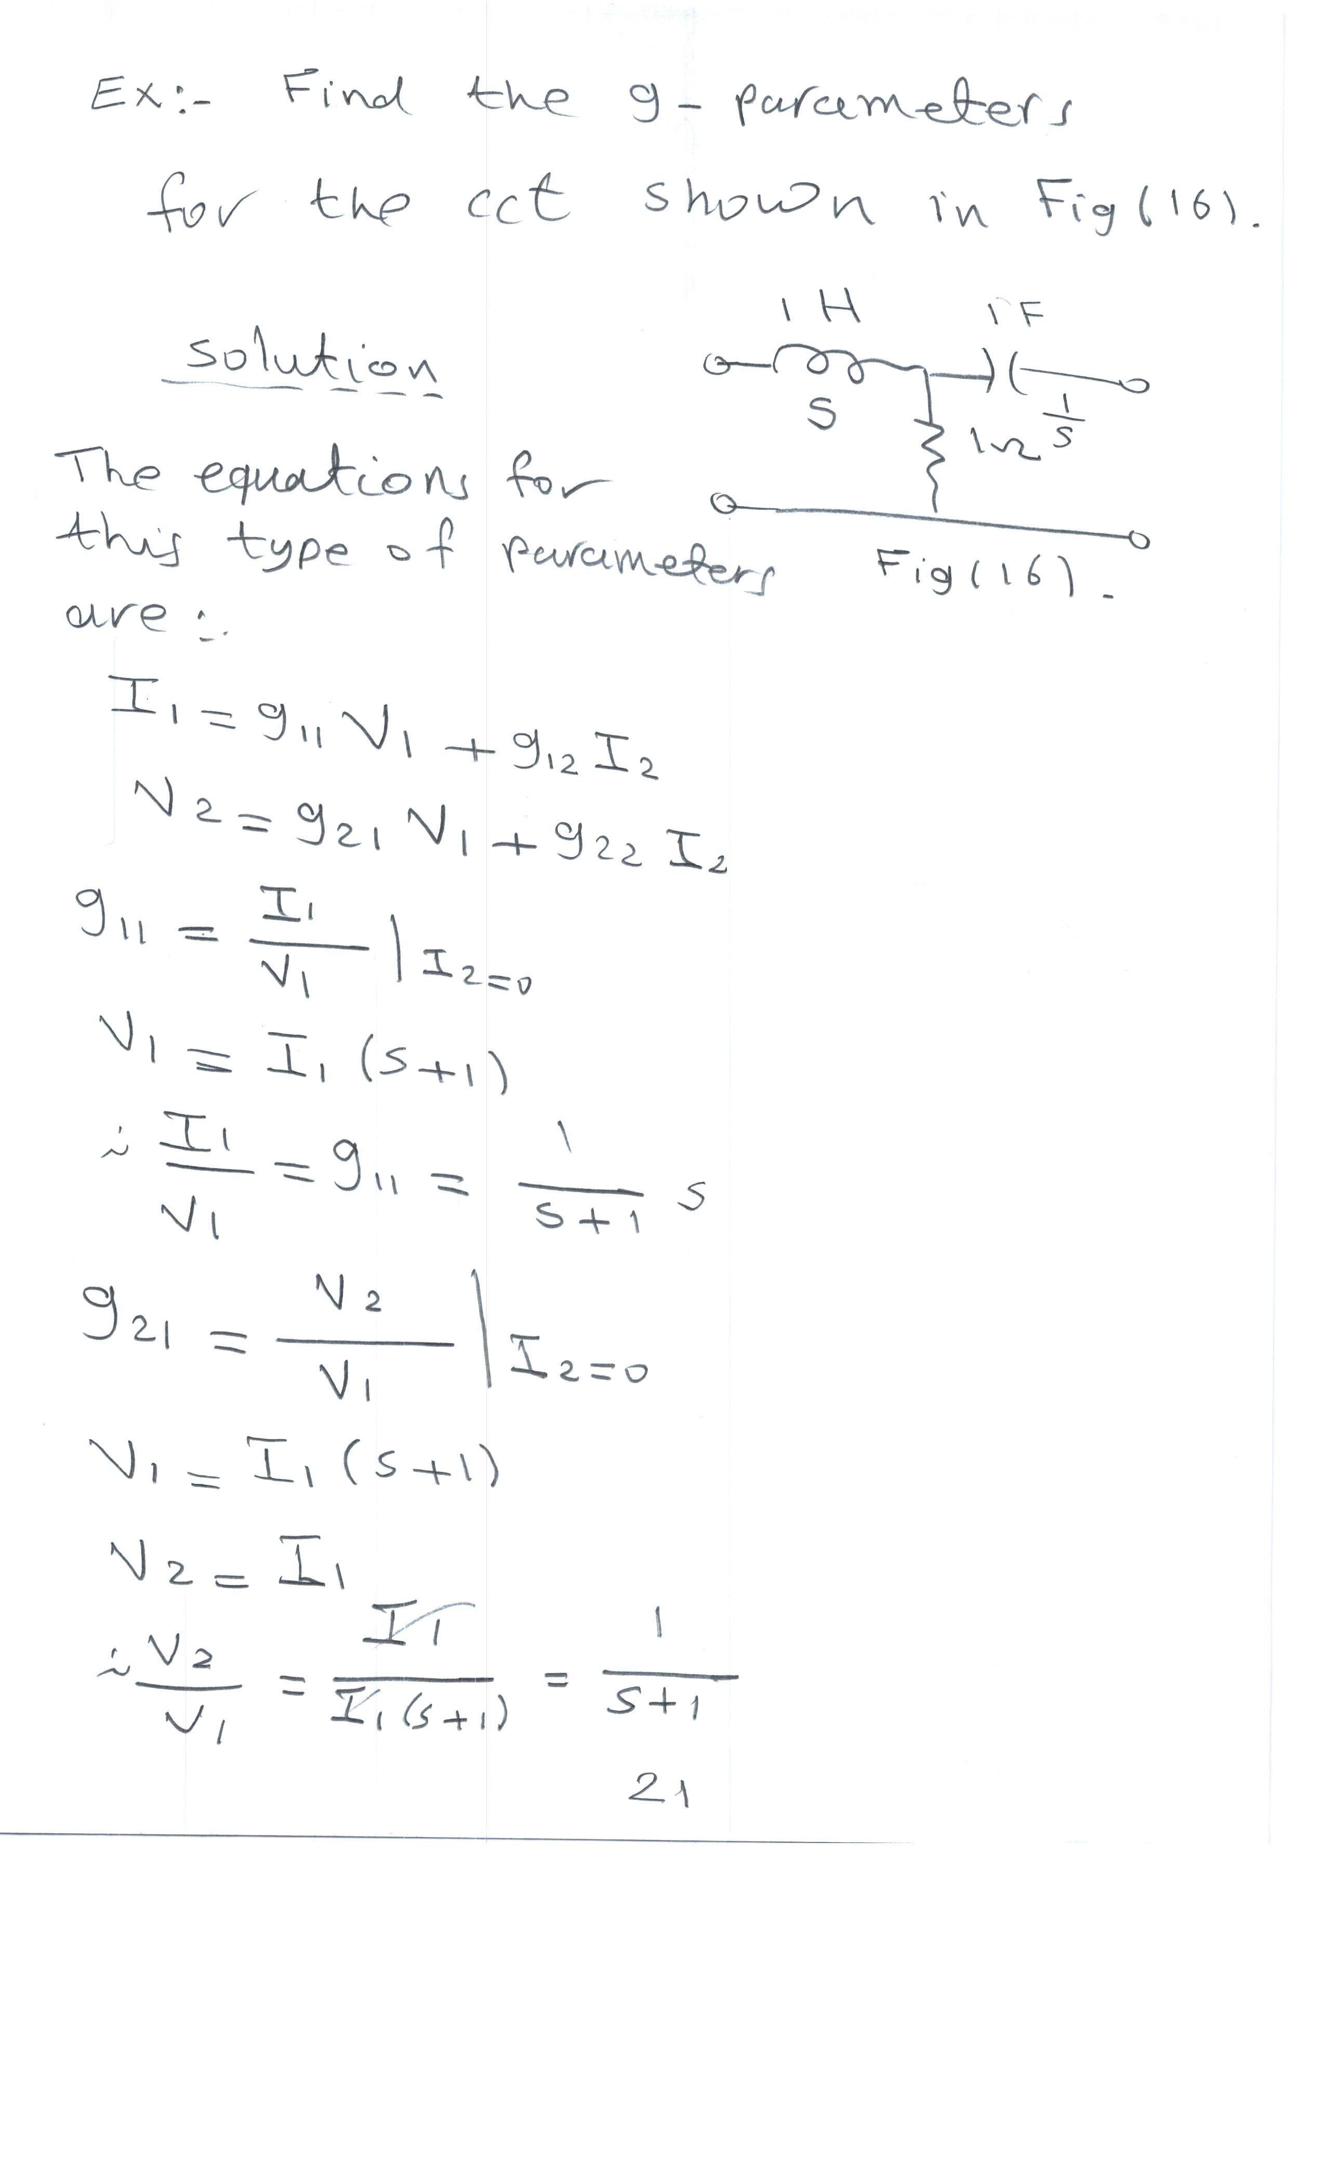

Slide 10
